Slide 1

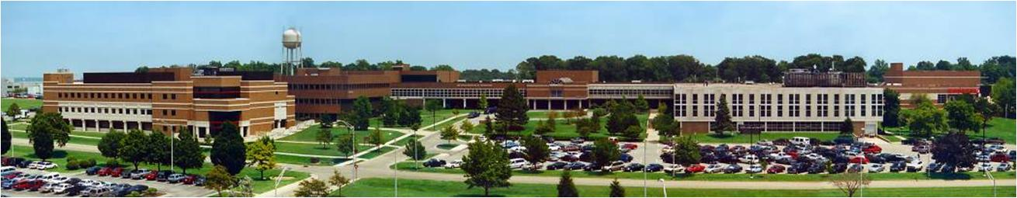
Air Force Institute of Technology
Calibration of the graphite pile at AFIT to account for ²⁴¹am Ingrowth in PuBe₁₃ Source
2Lt J. Bevins
17Mar09
E d u c a t i n g t h e W o r l d ’s B e s t M i l i t a r y

Slide 2
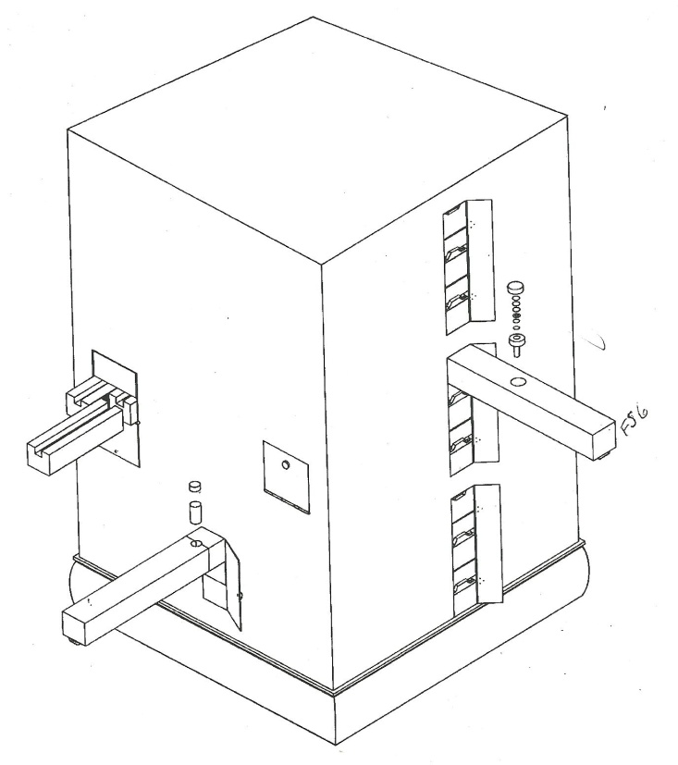
Outline
Objectives
Theory
Experiment & Results
Model & Results
Future Work
Conclusions
Questions
INTRO
THEORY
Experiment
MODEL
CONCLUSION

Slide 3
Objectives
Account for the effects caused by ingrowth of ²⁴¹Am from ²⁴¹Pu decay in PuBe₁₃ source
Obtain the axial thermal neutron flux profile of the AFIT graphite pile using foil irradiation
Construct a model of the graphite pile to produce a Monte Carlo estimate of the thermal neutron flux profile
INTRO
THEORY
EXPERIMENT
MODEL
CONCLUSION

Slide 4

Production of Activated Nuclei
Net rate of activated nuclei production:
where:
ϕ = neutron flux [1/cm² s]
N = number of nuclei in the sample
σ_{a} = effective activation cross section [cm²]
N' = number of radioactive nuclei present
λ = decay constant [1/min]
t = time [min]
Initial saturated activity:
where:
A_{s} = initial activity [1/t_{c}]
nv₀ = neutron flux [1/cm² s]
INTRO
THEORY
EXPERIMENT
MODEL
CONCLUSION
EDUCATING THE WORLD’S BEST MILITARY
WWW.AFIT.EDU 4

Slide 5
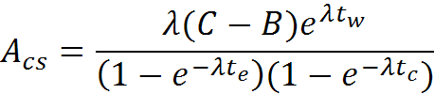
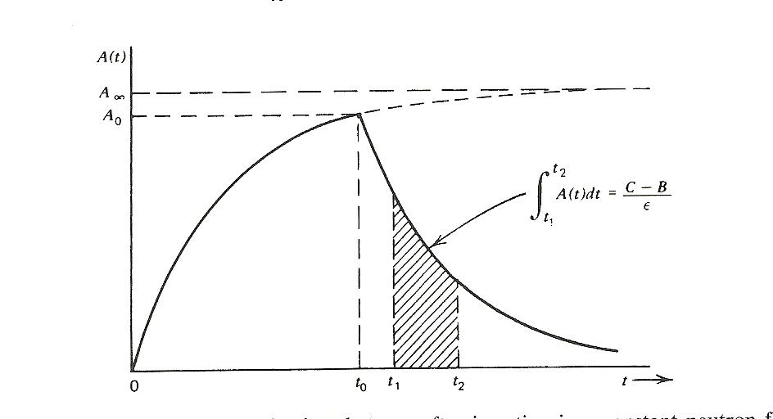

Saturated Activity Corrections
Timing Corrections:
where:
A_{cs} = corrected activity for tw, te, and tc to saturation
C = irradiated foil counts
B = background counts
t_{w} = time between counting and irradiation [min]
t_{e} = time irradiated [min]
t_{c} = time counted [min]
Resonance escape correction
where:
F_{Cd} = the resonance escape factor for cadmium
A_{Cd} = activity measured activity of the cadmium foil A_{th} = activity corrected to a cadmium difference thermal activity
INTRO
THEORY
EXPERIMENT
MODEL
CONCLUSION

Slide 6

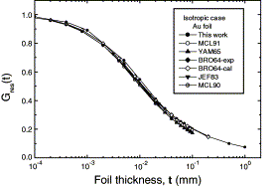
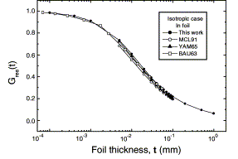
Saturated Activity Corrections
Flux Depression Corrections:
where:
ά = average probability of absorption of a neutron
λ_{tr} = transport mean free path [cm]
R = radius of foil [cm]
Self-Absorption correction
INTRO
Quantity | Value
μ_{In} | 5.135 cm⁻¹ [5]
μ_{Au} | 5.011 cm⁻¹ [5]
d_{In} = d_{Au} | 0.00508 cm
ά_{In} ά_{Au} R_{In} = R_{au} | ~0.045 [4] ~0.045 [4] 2.7 cm [4] 0.9144 cm 1.0052 (10) 1.0052 (10)
THEORY
EXPERIMENT
MODEL
CONCLUSION
Au Foil
In Foil

Slide 7



Determination of Thermal Flux
Incorporating the correction factors:
Assuming the cross section varies as 1/v:
A known flux and saturated counting rates can be used to find an unknown flux of similar magnitude:
INTRO
THEORY
EXPERIMENT
MODEL
CONCLUSION

Slide 8
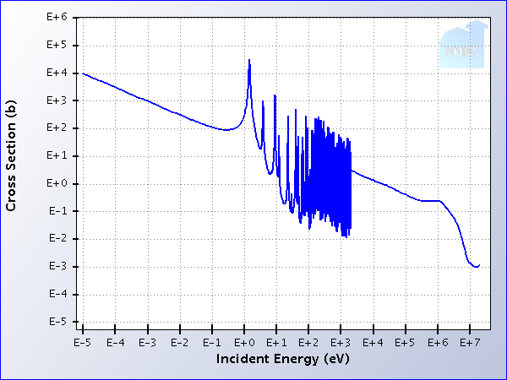
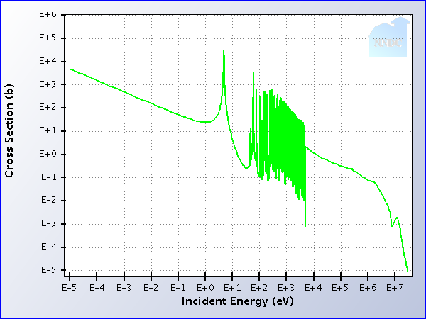

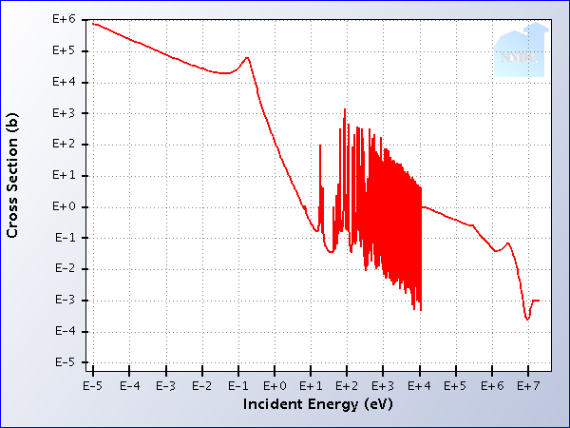
Important Cross Sections
INTRO
THEORY
EXPERIMENT
¹⁹⁷Au + ¹n ¹⁹⁸Au
^{t}_{1/2} ^{= 54.2 min}
^{t}_{1/2} ^{= 2.7 days}
MODEL
CONCLUSION
CONCLUSION
Cd(n,γ)
EDUCATING THE WORLD’S BEST MILITARY
WWW.AFIT.EDU 8

Slide 9
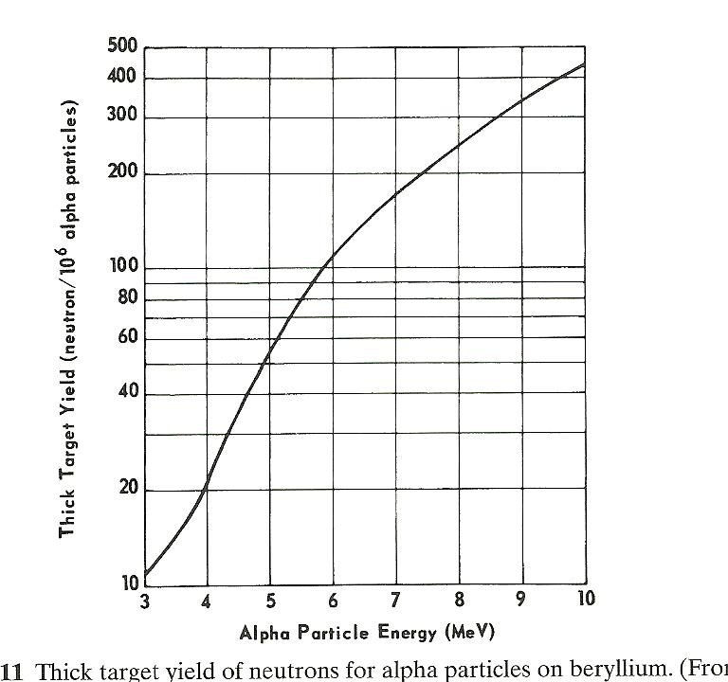
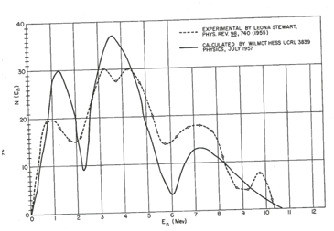
Alpha Particle Production
INTRO
THEORY
EXPERIMENT
MODEL
CONCLUSION

Slide 10
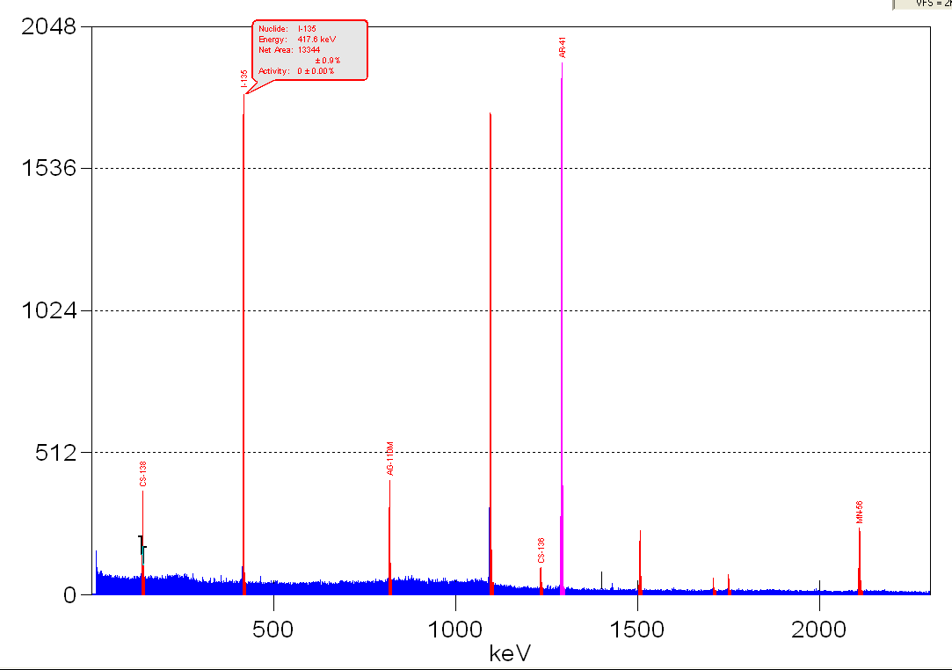
Indium Foil Irradiation Spectra
INTRO
1293 keV
THEORY
EXPERIMENT
MODEL
CONCLUSION
EDUCATING THE WORLD’S BEST MILITARY
WWW.AFIT.EDU 10

Slide 11
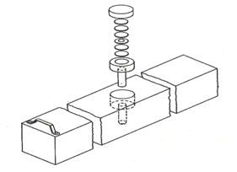
Foil Irradiation Data
Gold Foil “Standard Position” Flux Data
INTRO
Foil | Rs [1/t_{c}] | N | Flux | Uncertainty σ_{flux}
NBS AFIT #1 AFIT#2 | 1391 2464 2429 | 2.89E20 1.24E21 1.24E21 | 4230 1742 1718 | 212 90 88
AFIT#3 | 2437 | 1.24E21 | 1723 | 89
THEORY
Indium Foil Cadmium Difference Thermal Flux Data
EXPERIMENT
Position | Rs/N [1/t_{c}] | Flux | Uncertainty σ_{flux} | % Increase
1 2 3 | 1.78E-18 3.66E-18 4.16E-18 | 3730 7945 9028 | 194 413 469 | 15.5 14.8 14.0
4 5 6 7 8 9 | 3.12E-18 1.70E-18 7.96E-19 3.73E-19 1.57E-19 5.52E-20 | 6778 3699 1728 808 341 120 | 352 193 89 43 18 7 | 18.5 16.3 17.5 25.0 28.8 37.9
MODEL
CONCLUSION
EDUCATING THE WORLD’S BEST MILITARY
WWW.AFIT.EDU 11

Slide 12
Relaxation Length
INTRO
THEORY
EXPERIMENT
MODEL
CONCLUSION
EDUCATING THE WORLD’S BEST MILITARY
WWW.AFIT.EDU 12

Slide 13
Axial Thermal Neutron Flux Profile
INTRO
THEORY
EXPERIMENT
MODEL
CONCLUSION
EDUCATING THE WORLD’S BEST MILITARY
WWW.AFIT.EDU 13

Slide 14
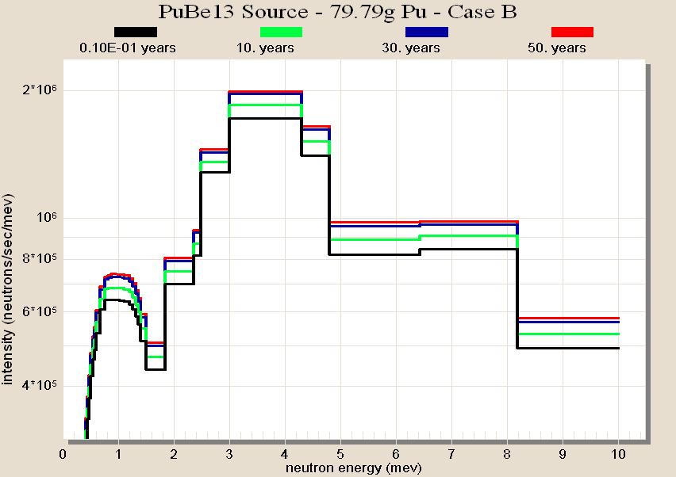
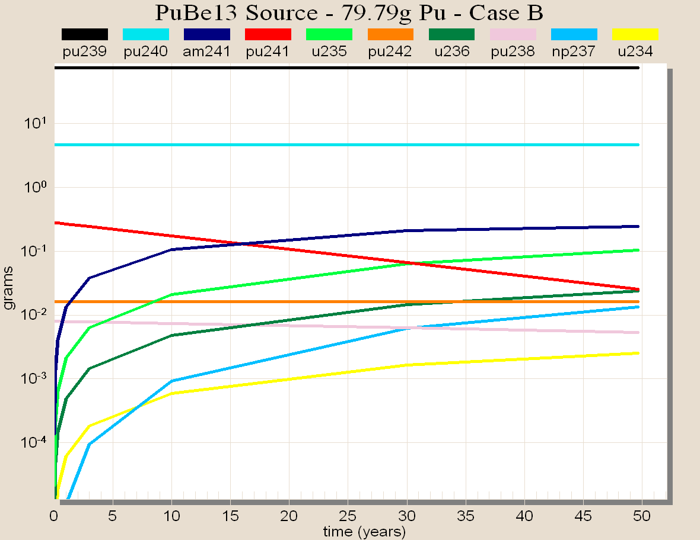
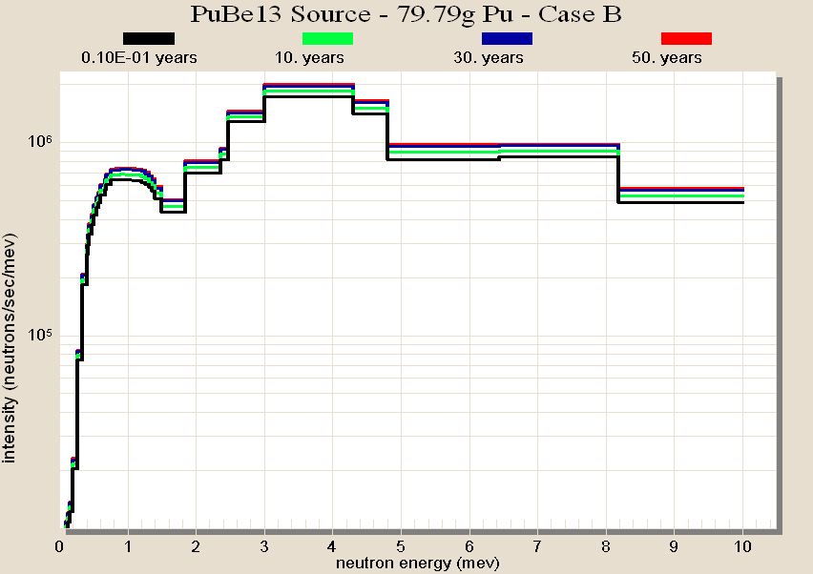
ORIGENS Source Change
INTRO
THEORY
EXPERIMENT
Starting PuBe Source Composition Data
MODEL
 | Case A | Case B | Case C | Case D | Case E
⁹Be(g) ²³⁸Pu (g) | 39.11 0.00 | 39.11 8.0E-3 | 39.11 8.0E-3 | 26.22 5.4E-3 | 37.15 3.8E-3
²³⁹Pu (g) ²⁴⁰Pu (g) ²⁴¹Pu (g) ²⁴²Pu (g) Activity -(Ci ²³⁹Pu ) Strength (n/s) | 79.70 0.08 8E-05 0.00 4.96 7.27E6 | 75.15 4.67 0.28 0.016 4.96 8.63E6 | 75.91 3.86 0.35 0.00 4.96 8.43E6 | 51.53 2.05 1.2E-2 0.00 3.32 5.54E6 | 73.44 2.21 0.460 0.00 4.71 7.52E6
CONCLUSION
EDUCATING THE WORLD’S BEST MILITARY
WWW.AFIT.EDU 14

Slide 15
SOURCES4C
INTRO
THEORY
EXPERIMENT
Source Strength Data
MODEL
Case | 1960 Strength [n/s] | 2010 Strength [n/s] | Percent Change
A | 7.27E+06 | 7.26E+06 | 0.0%
B | 8.63E+06 | 1.01E+07 | 17.0%
C | 8.43E+06 | 1.02E+07 | 21.0%
D | 5.54E+06 | - | -
E | 7.52E+06 | 9.89E+06 | 31.5%
CONCLUSION
EDUCATING THE WORLD’S BEST MILITARY
WWW.AFIT.EDU 15

Slide 16
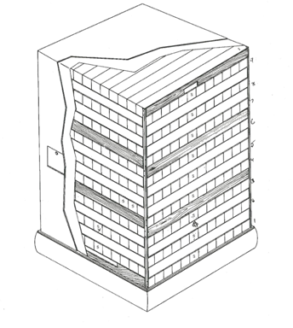
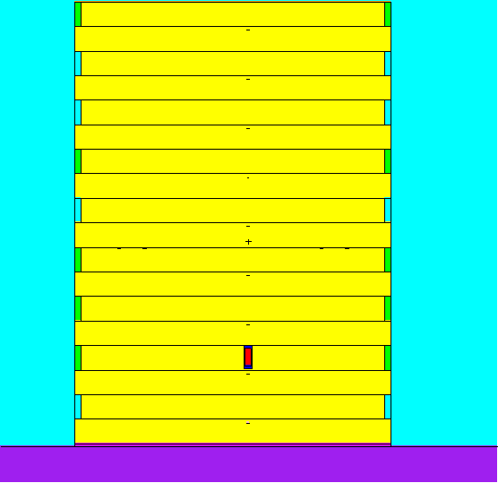
MCNP5
INTRO
THEORY
EXPERIMENT
MODEL
MCNP Model Color Code
Color | Material
Purple | ORNL Concrete
Pink Yellow Aqua Green Red Dark Blue | Aluminum Base Graphite Air Wood Supports PuBe Source Stainless Steel Encapsulation
CONCLUSION
EDUCATING THE WORLD’S BEST MILITARY
WWW.AFIT.EDU 16

Slide 17
MCNP5
INTRO
1960 and 2010 thermal flux results obtained with MCNP
Position | 1960 Flux | 1960 Uncertainty σ_{flux} | % Increase | 2010 Flux | 2010 Uncertainty σ_{flux}
1 2 3 | 5595 9261 10609 | 60 105 112 | 73.2 33.8 34.0 | 6418 10709 12236 | 67 117 128
4 5 6 7 8 9 | 7576 4040 1930 872 370 120 | 65 34 15 7 5 2 | 32.4 27.0 31.3 34.8 39.6 38.4 | 8914 4724 2220 1008 437 136 | 78 39 18 8 5 2
THEORY
EXPERIMENT
MODEL
CONCLUSION
EDUCATING THE WORLD’S BEST MILITARY
WWW.AFIT.EDU 17

Slide 18
MCNP5
INTRO
Comparison of 2010 Bias Corrected Model and Experimental Thermal Flux
THEORY
Position | Experimental Flux | Uncertainty σ_{flux} | Bias Corrected Model Flux | Uncertainty σ_{flux}
2 3 4 5 6 7 | 7945 9028 6778 3699 1728 808 | 413 469 352 193 89 43 | 8099 9253 6741 3573 1679 762 | 63 72 52 28 13 6
EXPERIMENT
MODEL
CONCLUSION
EDUCATING THE WORLD’S BEST MILITARY
WWW.AFIT.EDU 18

Slide 19
Model Relaxation Length
INTRO
THEORY
EXPERIMENT
MODEL
CONCLUSION
EDUCATING THE WORLD’S BEST MILITARY
WWW.AFIT.EDU 19

Slide 20
Axial Thermal Neutron Flux Profile
INTRO
THEORY
EXPERIMENT
MODEL
CONCLUSION
EDUCATING THE WORLD’S BEST MILITARY
WWW.AFIT.EDU 20

Slide 21
Future Work
Gold Foil Measurements
Obtain cadmium covered gold foil measurement
Quantify variance in 2PI proportional detectors
Multiple Foil Flux Depression
Results indicated that there was significant, non-constant flux depression in “fully loaded” pile
Investigate each position and improve statistics
²⁴¹Pu Concentration
Single most important factor in model
Could be accomplished by gamma spectroscopy with HPGe if properly shielded from neutrons
Model
Determine source of bias
Use problem specific cross sections in ORIGENS
INTRO
THEORY
MODEL
EXPERIMENT
CONCLUSION

Slide 22
Conclusion
Source Composition Change
Due to 241Am ingrowth the source strength increased 17%
Current source strength: 1.007*10⁷ n/s
No appreciable change in the neutron energy spectrum
Axial Flux Profile
The current cadmium difference thermal flux at the “standard position” is 1728 + 89 n/cm² s
MCNP models produced a bias of ~32% in the 1960 and 2010 data.
Correcting for the average bias, the standard position cadmium difference thermal flux was 1679 + 13 n/cm² s
Graphite pile properties
The relaxation length was found to be 26.3 cm and 26.1cm for experimental and model, respectively
INTRO
THEORY
MODEL
EXPERIMENT
CONCLUSION

Slide 23
Questions

Slide 24
References
[1] “AF NETF Graphite Standard Pile”, WADD-TR-61-174, Air Force Systems Command (1962).
[2] National Nuclear Data Center, Evaluated Nuclear Data File, “Sigma: Retrieval and Plotting”, Available: http://www.nndc.bnl.gov/sigma/ .
[3] G. Knoll, Radiation Detection and Measurement, p. 21-24 & 744-749, John Wiley & Sons, Hoboken, New Jersey, (2000).
[4] C. Tittle, “Slow-Neutron Detection by Foils-II”, Nucleonics, 9, 60 (1951).
[5] National Institute of Standards and Technology, NIST Center for Neutron Research, “Compute Neutron Attenuation and Activation”, Available: http://www.ncnr.nist.gov/instruments/bt1/neutron.html.
[6] J. PETROSKY, “Concepts of Neutron Dosimetry”, unpublished.
[7] I. GONCALVES, E. MARTINHO, AND J.SALGADO, “Monte Carlo Calculation of Epithermal Neutron Resonance Self-Shielding Factors in Foils of Different Materials,” Applied Radiation and Isotopes, 56, 945 (2002).
[8] C. Tittle, “Slow-Neutron Detection by Foils-I”, Nucleonics, 8, 5 (1951).
[9] X-5 MONTE CARLO TEAM, “MCNP-A General Monte Carlo N-Particle Transport Code, Version 5,” Los Alamos National Lab (2008).
[10] I. GAULD, O.HERMANN, AND R.WESTFALL, “ORIGEN-S: Scale System Module to Calculate Fuel Depletion, Actinide Transmutation, Fission Product Buildup and Decay, and Associated Radiation Source Terms,” Oak Ridge National Lab, Nuclear Science and Technology Division (2009).
[11] W. WILSON, et al, “SOURCES4C: A Code for Calculating (α,n), Spontaneous Fission, and Delayed Neutron Sources and Spectra,” Los Alamos National Laboratory (2002).
[12] I. GAULD, (personal communication, 02Mar2010).
[13] E. Anderson, “Increases in Neutron Yields of Plutonium-Beryllium (α,n) Sources,” Nuclear Applications, 4, 142 (1967).
[14] E. Anderson, “Increases in Neutron Yields of ²³⁹Pu-Be (α,n) Sources-II,” Nuclear Technology, 52, 428 (1981).
[15] M. ROSSANO, “Flux and Spectrum of Neutrons Generated from 25MV Medical C-Ray Therapy Machine,” Thesis, Air Force Institute of Technology (1989).
[16] M. ANDERSON AND W. BOND, “The Neutron Spectrum of a Plutonium-Beryllium Source,” MonSanto Research Corporation, Mound Laboratory (1964).
[17] J. EZOLD, (personal communication, 15Mar2010).
[18] D. Bodansky, Nuclear Energy Principles, Practices, and Prospects, p.493, Springer-Verlag, New York, New York (2004).
[19] G. GUTHRIE, “Neutron Beam Facility Technical Report,” Douglas United Nuclear (1965).

Slide 25
EXTRA SLIDES

Slide 26
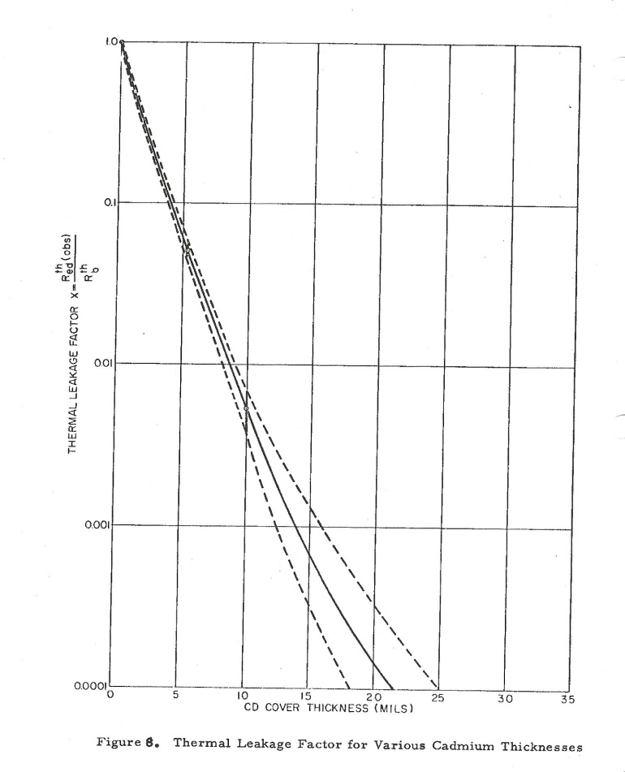
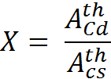


Saturated Activity Corrections
Thermal Leakage Corrections:
where:
X = thermal neutron leakage factor
Detector Efficiency Correction
where:
ε = efficiency of the detector
INTRO
THEORY
MODEL
EXPERIMENT
CONCLUSION

Slide 27
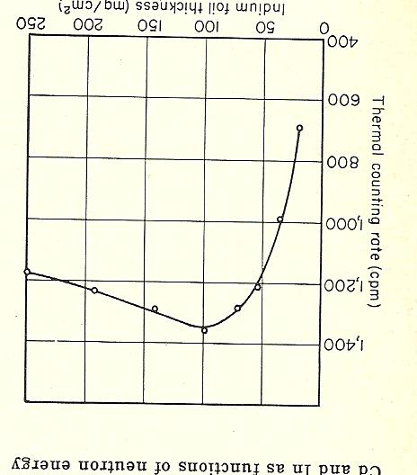
Foil Thickness
INTRO
THEORY
MODEL
EXPERIMENT
CONCLUSION

Slide 28
2π Gas Proportion Detector Optimization
2 π P-10 Detector
Preamp
Amp
TSCA
INTRO
Bias Voltage Supply
Oscilloscope
Oscilloscope
THEORY
EXPERIMENT
Saturation
MODEL
CONCLUSION
EDUCATING THE WORLD’S BEST MILITARY
WWW.AFIT.EDU 28

Slide 29
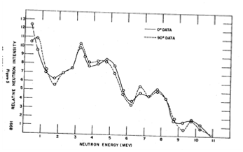
Alpha Particle Production
INTRO
THEORY
MODEL
EXPERIMENT
CONCLUSION

Slide 30
2π Gas Proportion Detector Optimization
Counting System Settings Based on ¹⁹⁷Au Counting Curve
INTRO
Gold Foil Characteristics
CG | 20
FG | 0.5
Shaping Time Bias LCD | 2 μsec 1700V 0.15 (Integral Mode)
Thickness | 0.002” (0.00508cm)
Diameter | 0.720” (1.8288cm)
Mass λ_{Au} | 0.4059 g 1.79E-04 min⁻¹ 1.03 [1]
THEORY
Gold Foil Counting Data – Background = 926/20min
EXPERIMENT
Description | T_{e} [min] | T_{w} [min] | T_{c} [min] | Counts
1600V, 50CG | 5516.22 | 2.43 | 20 | 26764
1600V, 50CG 1600V, 50CG 1625V, 50CG 1600V, 50CG 1600V, 50CG, No Window 1700V, 20CG 1700V, 20CG 1700V, 20CG | 5516.22 5516.22 5516.22 5516.22 5516.22 5516.22 5516.22 5516.22 | 26.25 49.25 1895.25 1916.25 1953.25 2029.25 2050.25 2071.25 | 20 20 20 20 20 20 20 20 | 26259 26373 20037 19545 19862 22377 21996 21984
MODEL
CONCLUSION
EDUCATING THE WORLD’S BEST MILITARY
WWW.AFIT.EDU 30

Slide 31
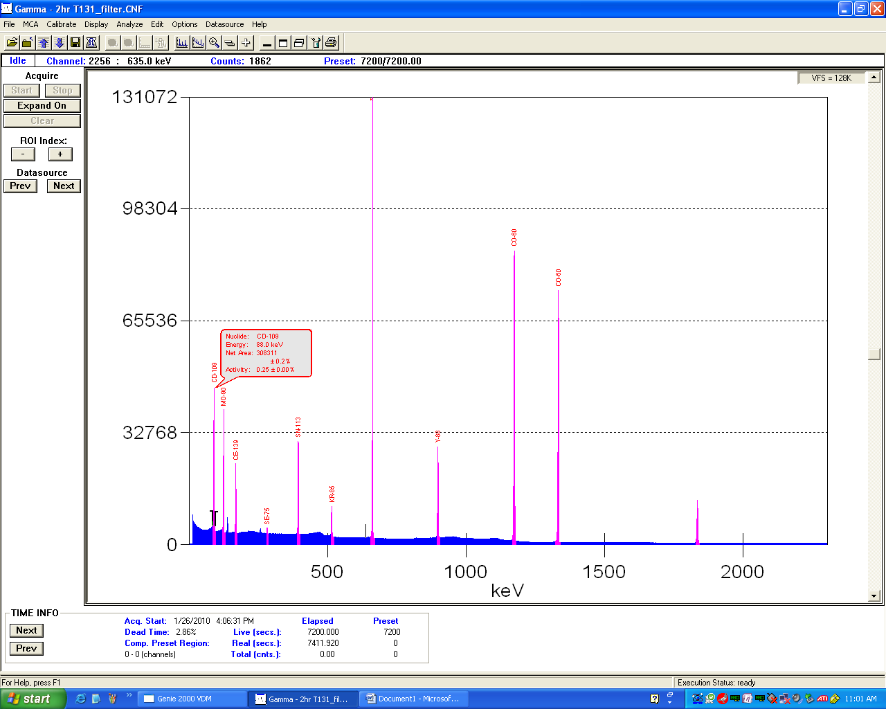
HPGe Detector Optimization
HPGe Detector
DSA 1000
Genie
INTRO
Oscilloscope
THEORY
Oscilloscope
EXPERIMENT
MODEL
CONCLUSION
EDUCATING THE WORLD’S BEST MILITARY
WWW.AFIT.EDU 31

Slide 32
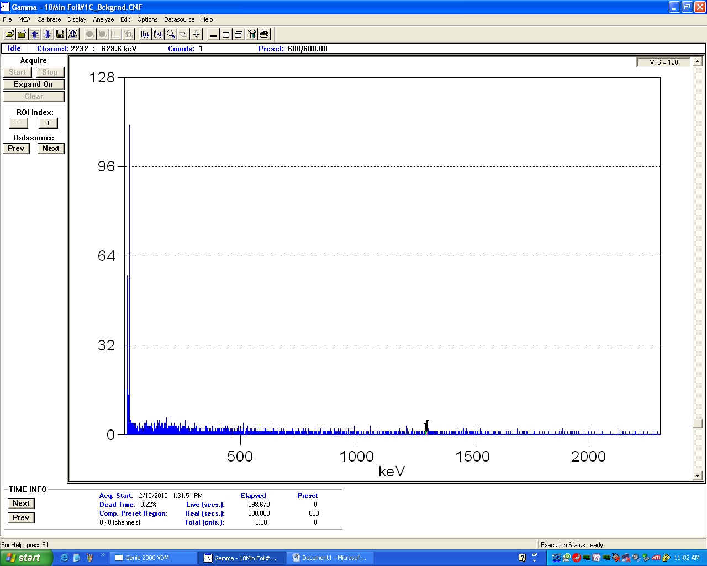
HPGe Detector Optimization
Indium Foil Characteristics
Counting System Settings for Spectroscopy
Thickness | 0.002” (0.00508cm)
Diameter | 0.720” (1.8288cm)
Mass λ_{In} | ~0.9 g 1.28E-02 min⁻¹ 1.08 [4]
CG | 5
FG | 1.4
Rise Time/Flat Top Bias BLR | 5.6/0.8 (+) 2998.8V Auto
INTRO
THEORY
EXPERIMENT
MODEL
CONCLUSION
EDUCATING THE WORLD’S BEST MILITARY
WWW.AFIT.EDU 32

Slide 33
Gold Foil Irradiation Raw Data
INTRO
Description | T_{e} [min] | T_{w} [min] | T_{c} [min] | Counts
1600V, 50CG | 5516.22 | 2.43 | 20 | 26764
1600V, 50CG 1600V, 50CG 1625V, 50CG 1600V, 50CG 1600V, 50CG, No Window 1700V, 20CG 1700V, 20CG 1700V, 20CG | 5516.22 5516.22 5516.22 5516.22 5516.22 5516.22 5516.22 5516.22 | 26.25 49.25 1895.25 1916.25 1953.25 2029.25 2050.25 2071.25 | 20 20 20 20 20 20 20 20 | 26259 26373 20037 19545 19862 22377 21996 21984
THEORY
EXPERIMENT
MODEL
CONCLUSION
EDUCATING THE WORLD’S BEST MILITARY
WWW.AFIT.EDU 33

Slide 34
Indium Foil Irradiation Raw Data
Foil Number | T_{e} [min] | T_{w} [min] | T_{c} [min] | Mass [g]
11 12 13 14 15 16 17 | 1324.32 1310.87 1297.12 1283.82 1270.38 1254.57 1240.90 | 1.38 1.53 1.55 1.52 1.45 1.60 1.52 | 10 10 10 10 10 10 10 | 0.0968 0.0892 0.0979 0.0925 0.0867 0.0823 0.0799
18 19 11C 12C 13C 14C 15C 16C 17C 18C 19C 11S 16S 11CS 16CS ISL ISR ISLC ISRC | 1225.22 1212.08 1289.68 1277.75 1406.98 1393.57 1378.80 1365.95 1333.95 1264.00 1249.62 1244.65 1271.47 1331.05 1354.57 940.52 953.72 1468.82 1483.13 | 1.62 1.40 1.45 1.38 2.05 1.43 2.17 1.52 1.58 2.27 1.55 1.27 1.30 1.65 1.23 1.67 1.62 1.43 1.68 | 10 10 10 10 10 10 10 10 10 10 10 10 10 10 10 10 10 10 10 | 0.0798 0.0777 0.0929 0.0847 0.0828 0.0835 0.0819 0.0826 0.0966 0.0840 0.0929 0.0954 0.0817 0.0932 0.0822 0.0802 0.0790 0.0834 0.0969
INTRO
THEORY
EXPERIMENT
MODEL
CONCLUSION
EDUCATING THE WORLD’S BEST MILITARY
WWW.AFIT.EDU 34

Slide 35
Indium Foil Flux Depression Data
INTRO
Foil # | Rs/N [1/t_{c}] | % Increase
11C | 6.45E-19 | -
11CS | 6.51E-19 | 0.85
16C | 2.82E-20 | -
16CS | 2.96E-20 | 4.78
11 | 2.36E-18 | -
11S | 2.42E-18 | 2.21
16 | 8.24E-19 | -
16S | 9.29E-19 | 11.26
THEORY
EXPERIMENT
MODEL
CONCLUSION
EDUCATING THE WORLD’S BEST MILITARY
WWW.AFIT.EDU 35

Slide 36
Age of Neutrons in Pile
INTRO
THEORY
EXPERIMENT
MODEL
CONCLUSION
EDUCATING THE WORLD’S BEST MILITARY
WWW.AFIT.EDU 36

Slide 37
Cd Ratio
INTRO
THEORY
EXPERIMENT
MODEL
CONCLUSION
EDUCATING THE WORLD’S BEST MILITARY
WWW.AFIT.EDU 37

Slide 38
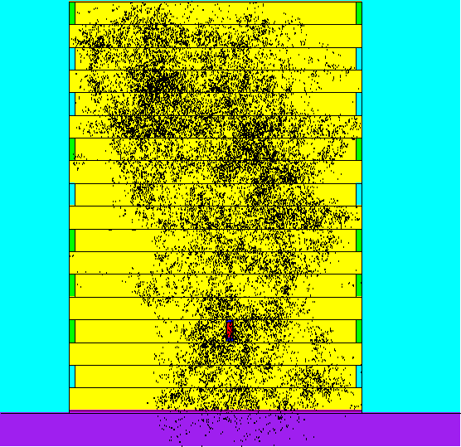
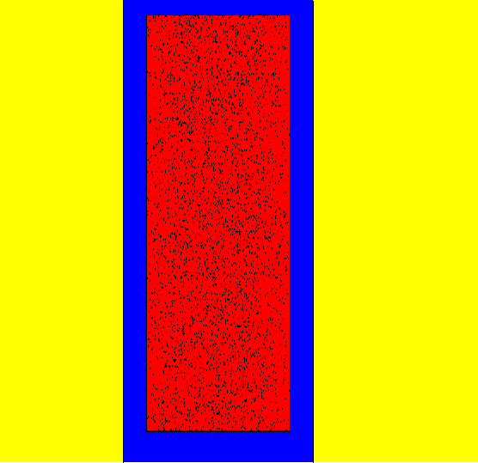
MCNP5
INTRO
THEORY
EXPERIMENT
MODEL
CONCLUSION
EDUCATING THE WORLD’S BEST MILITARY
WWW.AFIT.EDU 38

Slide 39
Model Cd Ratio
INTRO
THEORY
EXPERIMENT
MODEL
CONCLUSION
EDUCATING THE WORLD’S BEST MILITARY
WWW.AFIT.EDU 39

